Slide 1

Unit 2 The universal language
Welcome to the unit & Reading (I)
季佩丽 江苏省通州高级中学

Slide 2

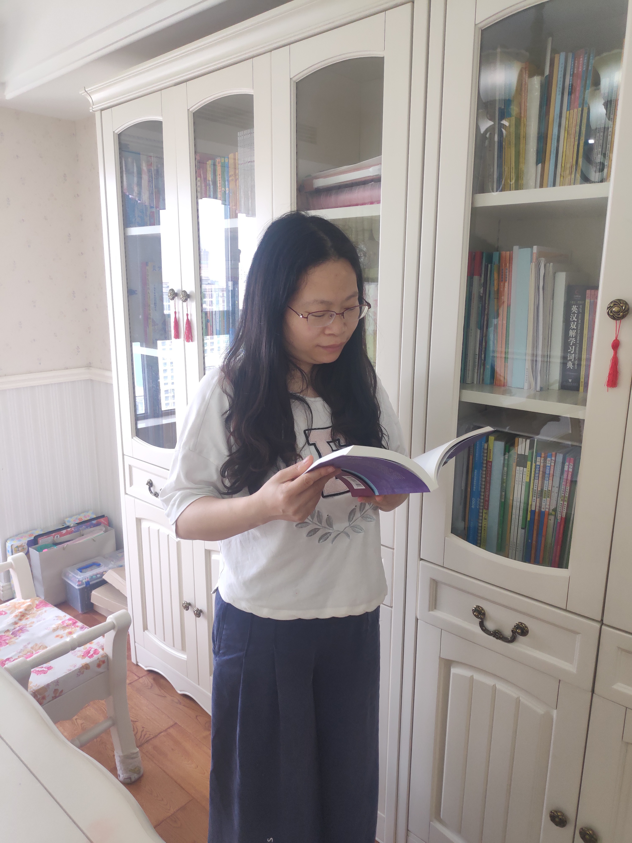
季佩丽
江苏省通州高级中学教师
曾获南通市优质课评比一等奖

Slide 3

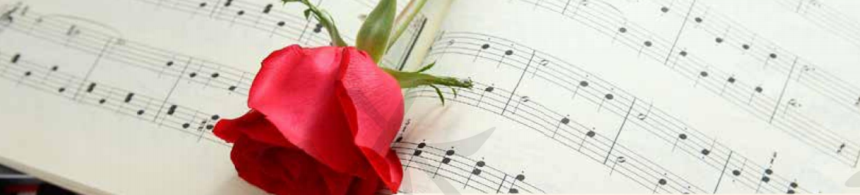
The universal language
Music is the utmost pleasure in life; music is the clear spring of life; music is the furnace of temperamental refinement.
－Xian Xinghai
Is music universal?

Slide 4
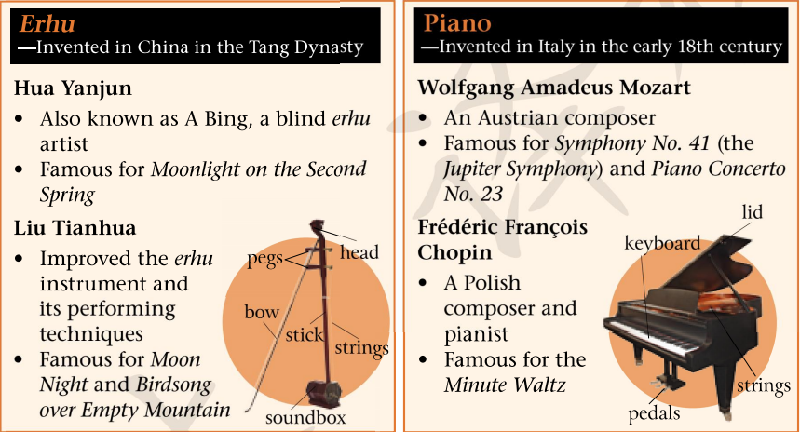

Slide 5
Read the two posters and fill in the table.
 | Er Hu |  | Piano
Invention Time
Name
Masterpiece(s)
Nationality
Tang Dynasty
the early 18th century
Wolfgang Amadeus Mozart
Frédéric Francois Chopin
Hua Yanjun
(A Bing)
Liu
Tianhua
● Symphony No. 41
● Piano Concerto
No. 23
Moonlight
on the Second Spring
● Moon Night
● Birdsong
over Empty Mountain
Minute Waltz
Chinese
Australian
Polish

Slide 6
List feelings evoked by the music.
Piano
Erhu
energetic
uplifting
joyful
sad
peaceful
relaxed
What can this universal language tell you?

Slide 7
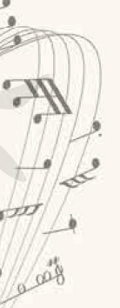

Email 1:
Understand ________ culture through _____________
Email 2:
Understand ________ culture through _____________
Chinese
Butterfly Lovers
Western
country music

Slide 8
Global reading
I watched a performance of Butterfly Lovers last night.
Para. 1
The story and music of Butterfly Lovers work well together.
Para. 2
Butterfly Lovers illustrates how wonderfully Chinese and Western musical elements can mix.
Para. 3

Slide 9
Global reading
Para. 1
My host family introduces me to country music.
Country music has a long history and it often features certain specific instruments and lyrics that leave you deep in thought.
Para. 2
Para. 3
Country music suggests a peaceful and simple life in rural America.
Para. 4
You should listen to some country music.

Slide 10
Detailed reading (email 1)
Basic information of the story
Plot
The lovers are separated by Zhu’s father.
Liang falls sick and dies.
Zhu weeps bitterly and jumps into his grave.
Climax
The couple transform into butterflies and fly away to be together forever.
Development
The two lovers spend three years at school together.
Ending
Beginning
The two lovers first meet.

Slide 11
Characteristics of the music
dramatic with heavier notes
Climax
taking a softer turn and ending on a bittersweet note
Development
fast and cheerful
Ending
Beginning
light and pleasant

Slide 12
Atmosphere created by the music
angry and sad
Climax
exciting
Development
happy
Ending
Beginning
as if whispering to the audience

Slide 13
Story-retelling
Story-retelling
first meet ...
spend three years ...
are separated ...
falls sick ...
weeps ...
finally the couple transforms ...
Liang shanbo
Zhu Yingtai
Zhu’s father
What’s the relationship between
the story and music?

Slide 14
Detailed reading (email 2)
History
●born out of blues and folk music
●became popular:
time: _____________
place: _____________________
in the 1940s
in the south of American
The typical instrument(s)
_____________
Examples
●The musician: ____________
●The song: _______________
Country music
John Denver
the guitar
“Take Me Home,
Country Roads”
Characteristics
● tunes: _________________
● lyrics: _____________
● themes: hardship, heartbreak
and hope
easy to sing
deep in thought

Slide 15
Critical reading
Comparison
Butterfly Lovers
“Take Me Home, Country Roads”
Music Type
violin concerto
country music
Instruments
violin
guitar
Theme
a loving story (Chinese)
peaceful green fields and simple life

Slide 16
Critical reading
How does the language—music prove universal in the two emails?
From the first email, we see by composing Chinese music using Western instruments, the composers show that music has no boundaries.
From the second email, we see the masters of country music like John Denver can make you feel the same without understanding the lyrics. It shows music is a form of communication that doesn’t require words.

Slide 17
Critical reading
Similarity
The 1st mail
The 2nd mail
●It’s a piece that really deserves to be heard.
●Why don’t you try to listen to some great country music?
●I guarantee you’ll enjoy it.
●You should definitely listen to ...—I bet you’ll like it.
recommendation

Slide 18
Post-reading
Listen to the whole piece of Butterfly Lovers.
Choose a section that impresses you most.
Discuss it with your partners.
Present a detailed description.

Slide 19
Example
What impresses me the most is the part when Liang and Zhu reunite after a long time of being apart. This part of music is so _________. At first, the melody sounds a bit ____________ with the violin showing the short happiness of their reunion. Then the tone becomes very _________, symbolizing their deep love. Gradually, the melody becomes lower, slower and very ______. The melancholic tone causes me to visualize a scene where the two of them are hugging and weeping, with their hearts bleeding.
touching
light-hearted
soft
sad

Slide 20
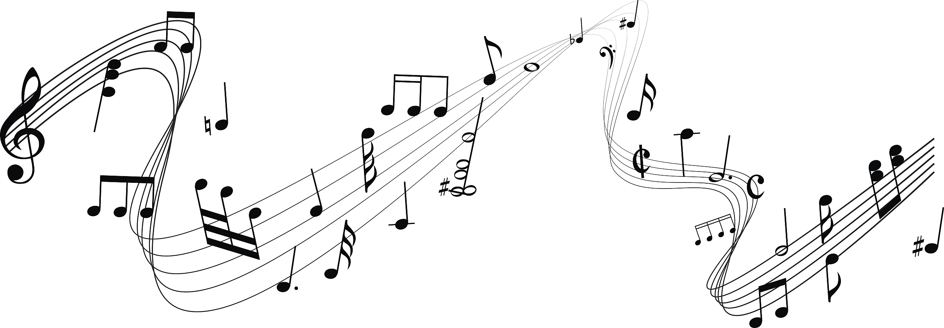
Homework
Write a letter to recommend a piece of traditional Chinese music to your foreign friends.

Slide 21


